Slide 1
BİL115
INTRODUCTION TO PROGRAMMING

Slide 2
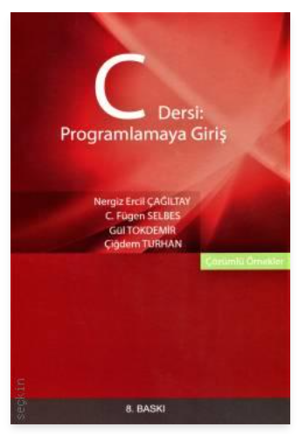
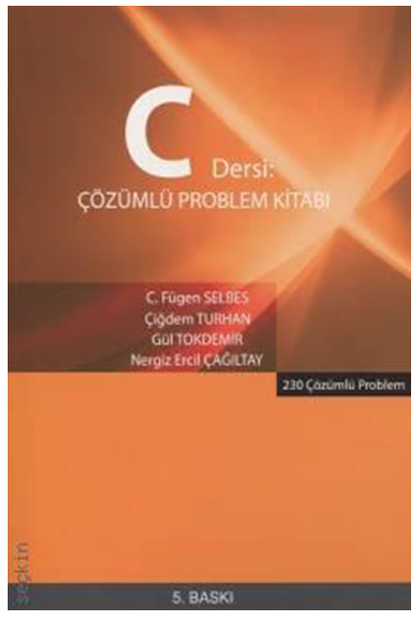
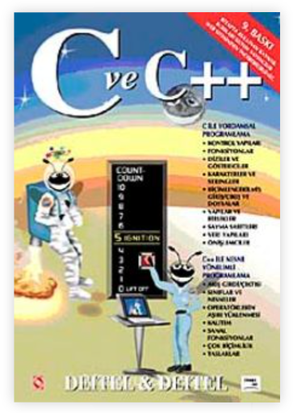
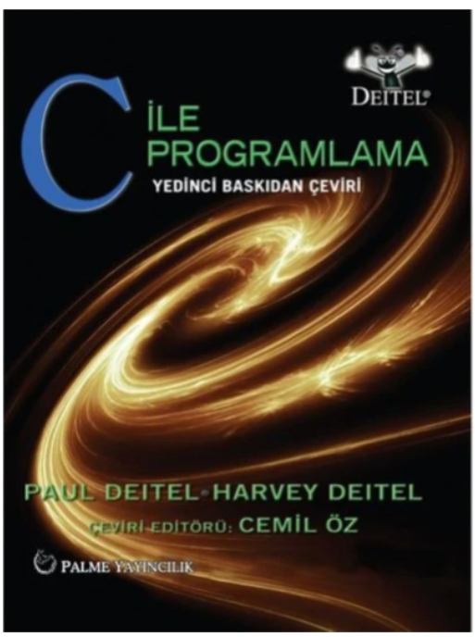

Grading
  40% midterm
  60% final

Slide 3

A computer system
A computer system is composed of:
  a monitor,
  a keyboard,
  a mouse,
  and a case (that contains several controlling components such as processor and alike),
  and also other peripherals like
    CD/DVD player (might have been included in the case),
    printer,
    scanner,
    modem,
    etc.
all connected together

Slide 4
Input and output devices
Input
/Output
Input
Input
/Output
Output
Output
Input
Input

Slide 5
A computer system
Everything we had in the previous slide is hardware.
  i.e., physical components that implement what is requested by the software.
APPLICATIONS
(Eg: Word, Excel, Explorer, MSN, C Compiler,
your own programs, etc.)
SOFTWARE
OPERATING SYSTEM
(Windows, Linux, MacOS, etc.)
HARDWARE

Slide 6
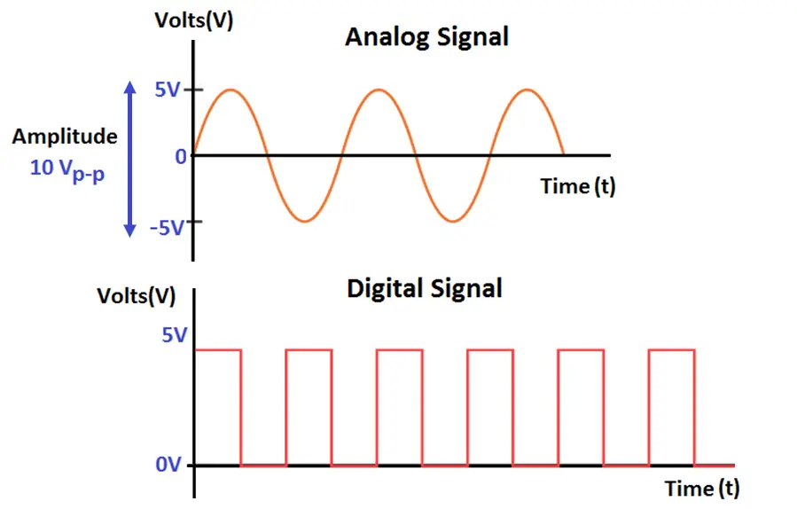
Analog Signal vs Digital Signal

Slide 7
How do we write programs?
We write our programs in
"C language" (which is an English-like language)
We use a compiler (such as GCC, Visual C, Borland C, etc.) to translate our program from "C language" to "machine language"
This is the executable code in "machine language."
This is the only thing the computer can understand and run (execute).
#include <stdio.h>
int main()
{
printf("Hello world!");
return 0;
}
Compile & Link
1110101011001001010001010100101000010010100101010101000101001000100101001
(machine code
or
executable code)
(source code)
(object code)

Slide 8
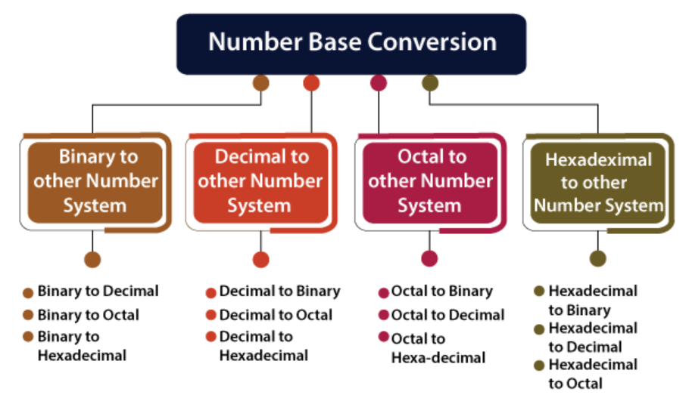
Base Conversion

Slide 9
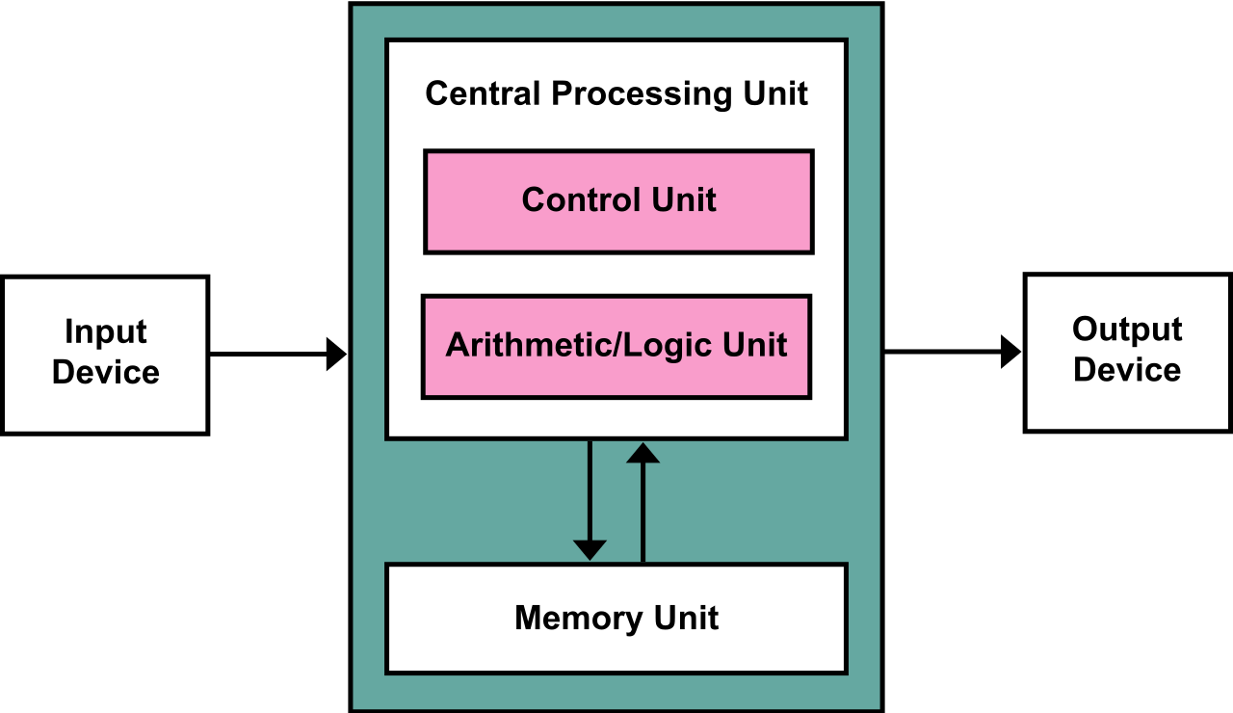
Von Neumann Architecture

Slide 10
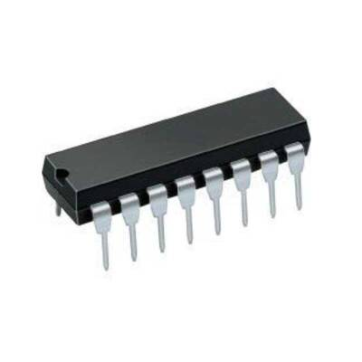
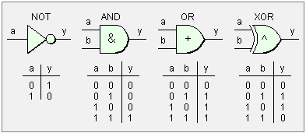
Logic Gates

Slide 11
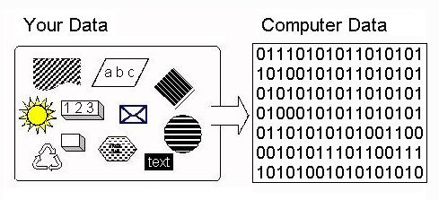
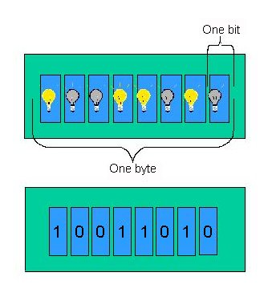
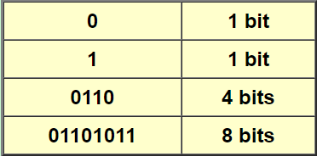
Binary Digit -BIT

Slide 12
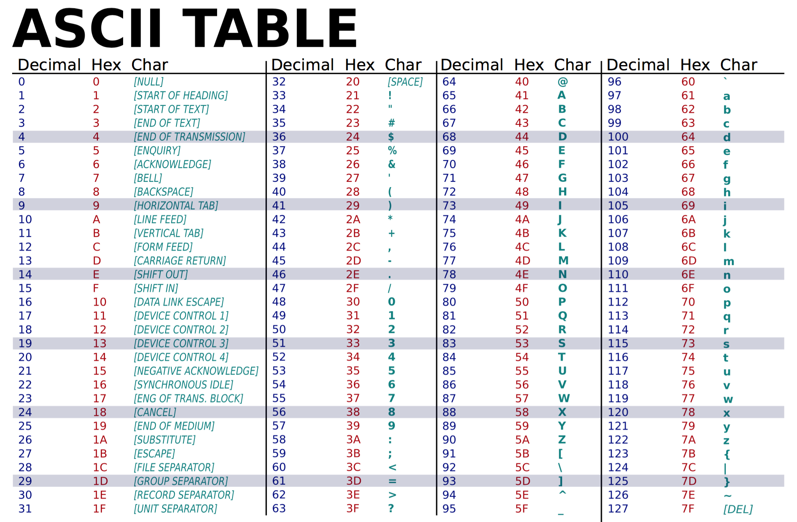
ASCII (American Standard Code for Information Interchange) Table

Slide 13
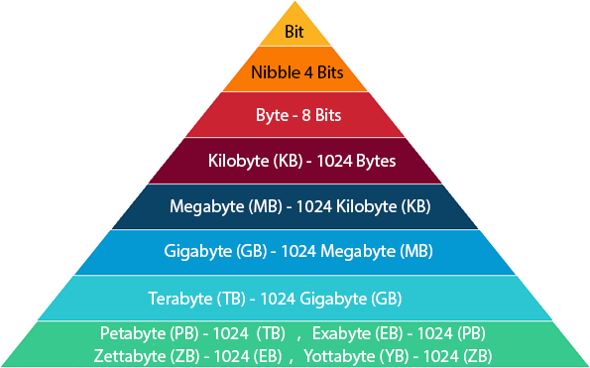
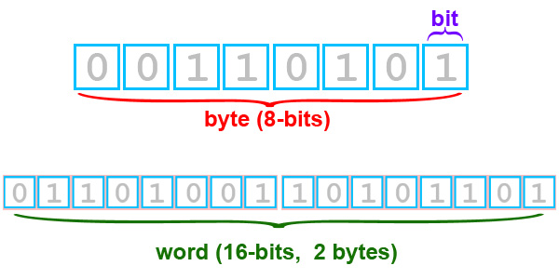
BIT-BYTE

Slide 14
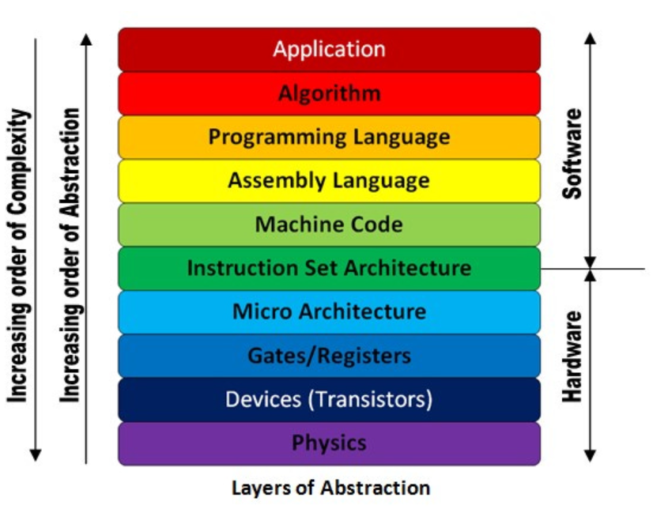
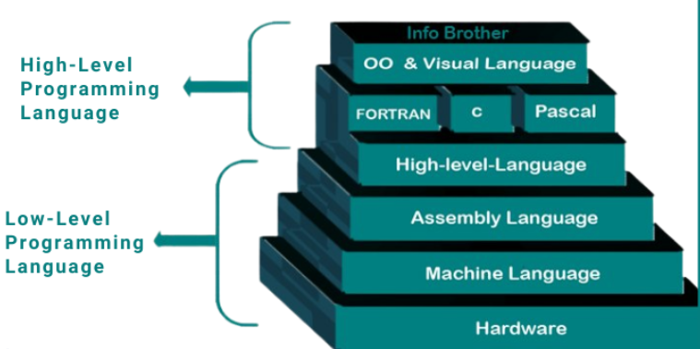
Programming Languages

Slide 15
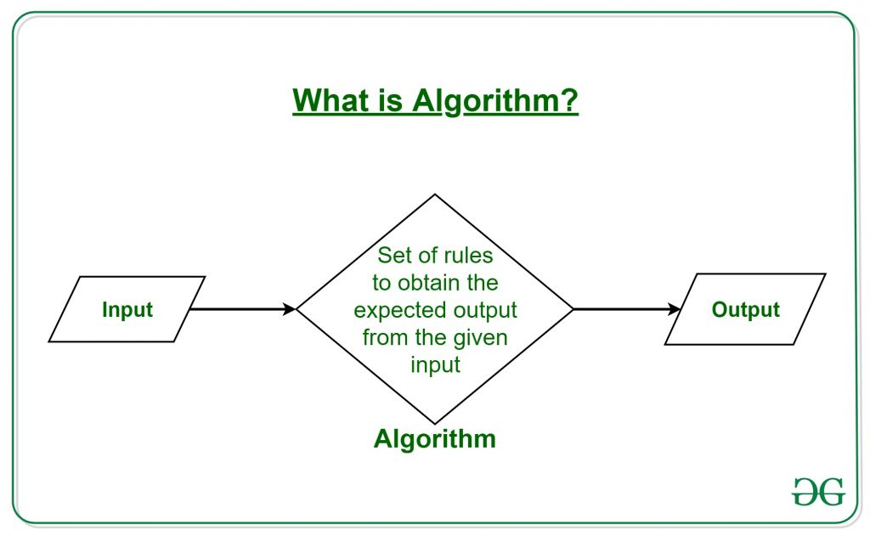
Algorithm

Slide 16
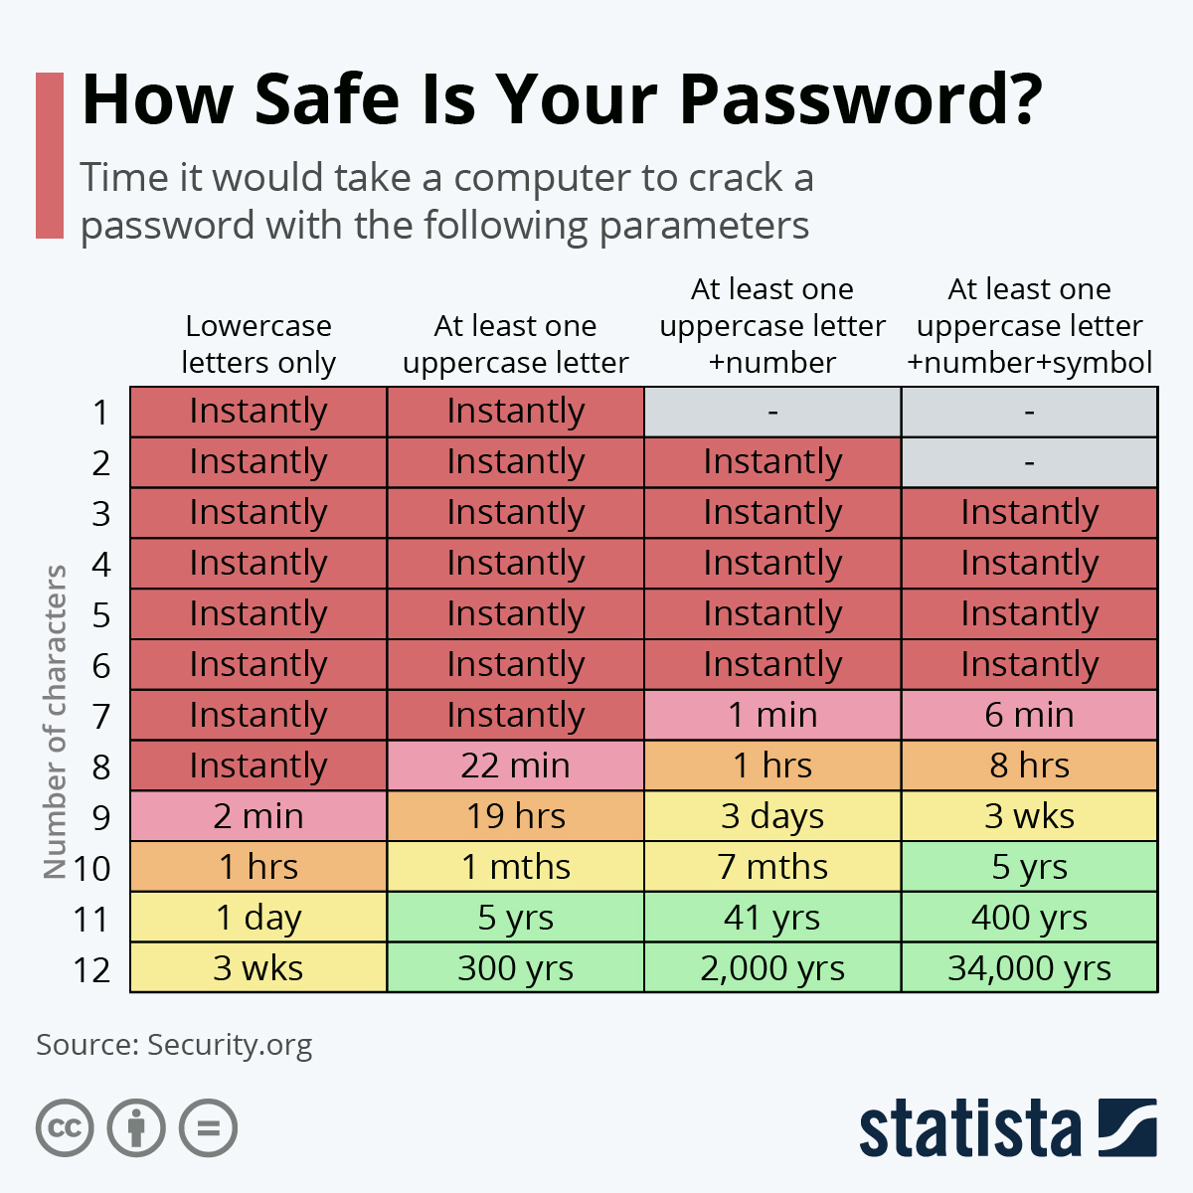
Password Security

Slide 17
VS
TIME
MEMORY

Slide 18
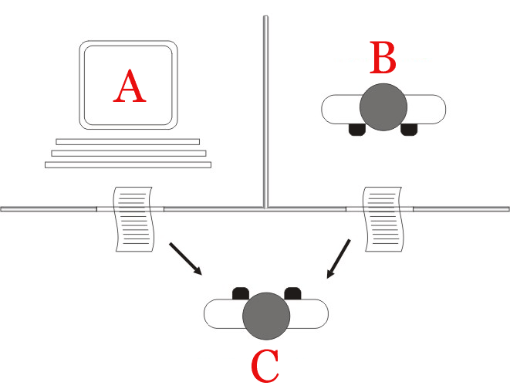
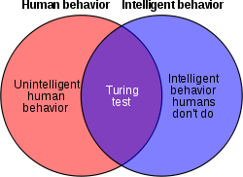
Can Machines Think?

Slide 19
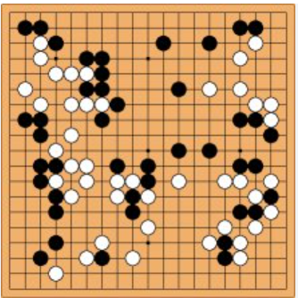
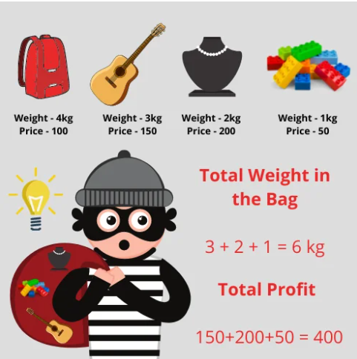
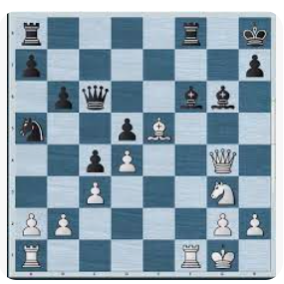
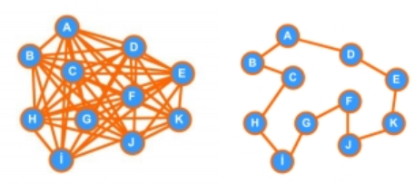
NP Problems
SAT problem:
(x) ∧ (y ∨ z) ∧ (x ∨ y ∨ z)
Knapcask problem:
Travelling salesman problem:

Slide 20
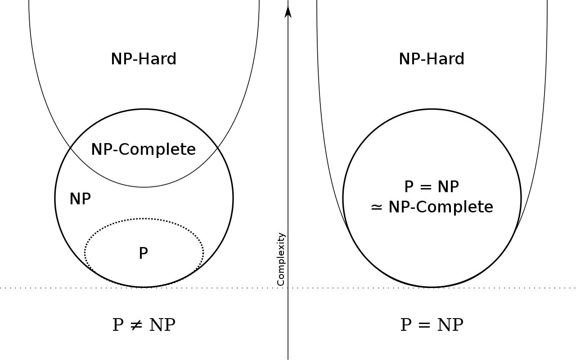
P vs NP https://www.claymath.org/millennium/p-vs-np/

Slide 21
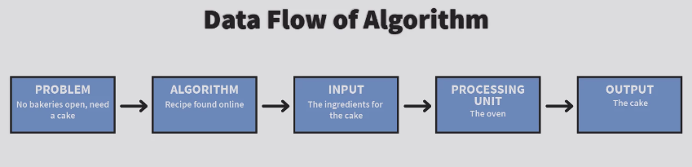
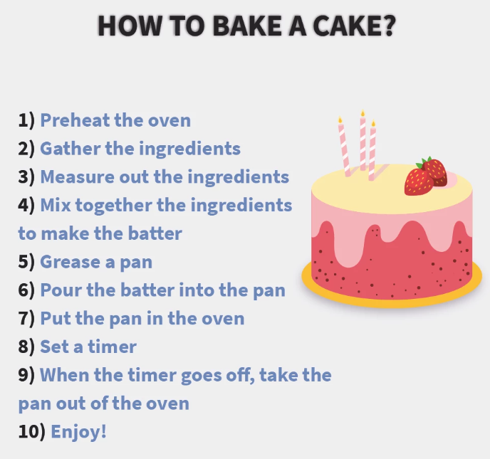

Slide 22
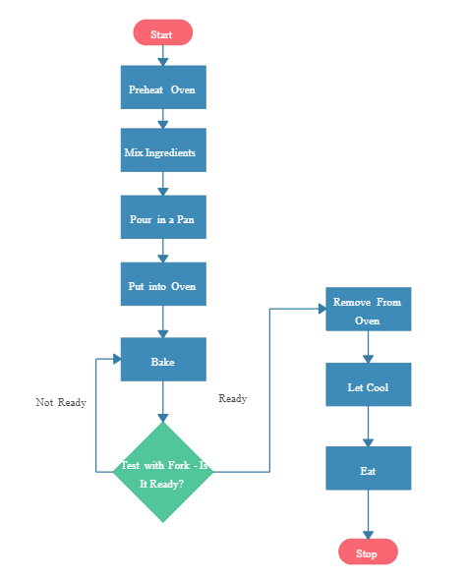
Flowcharts

